Slide 1
SENSOR & INSTRUMENTATION KOE 044 Unit 1

Slide 2
Contents:
Measurement System
Introduction & Definition of Sensor & Transducer
Selection & Classification of Sensors
Measurement of Displacement Using Potentiometer
LVDT
Optical Encoder,
Measurement of Force Using Strain Gauge
Measurement of Pressure Using LVDT based Diaphragm
Measurement of Pressure Using Piezoelectric Sensor

Slide 3
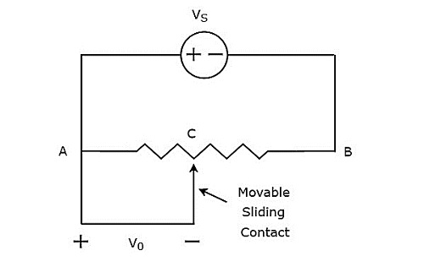
Measurement of Displacement Using Potentiometer

Slide 4
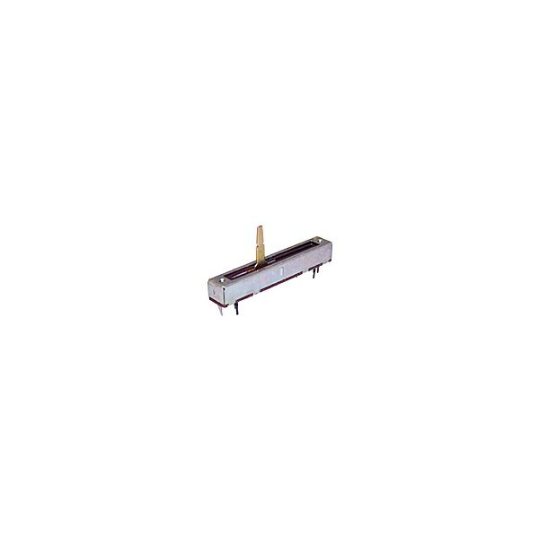
Measurement of Displacement Using Potentiometer

Slide 5
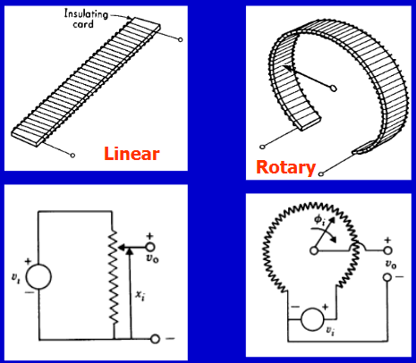
Measurement of Displacement Using Potentiometer

Slide 6
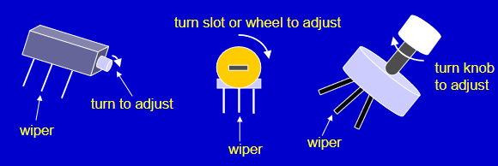
Measurement of Displacement Using Potentiometer

Slide 7
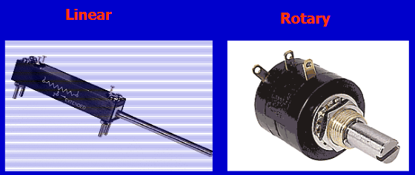
Measurement of Displacement Using Potentiometer

Slide 8
Measurement of Displacement Using Potentiometer
Important Performance Parameters
Potentiometer resolution
Potentiometer linearity

Slide 9
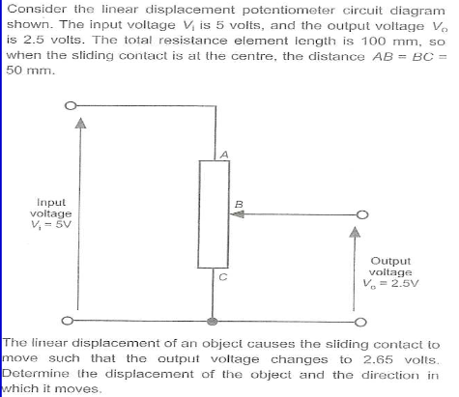
Measurement of Displacement Using Potentiometer
Problem Statement

Slide 10
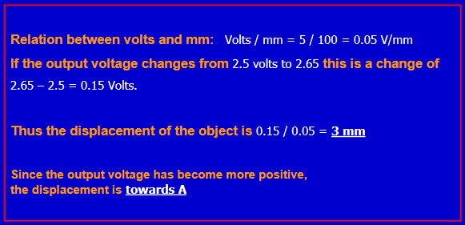
Measurement of Displacement Using Potentiometer
Solution

Slide 11
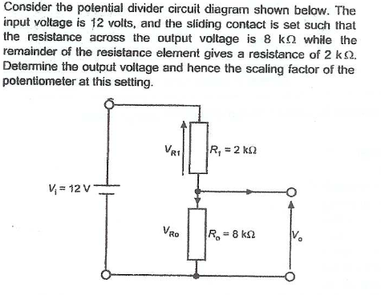
Measurement of Displacement Using Potentiometer
Problem Statement

Slide 12
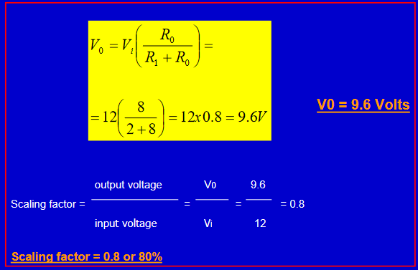
Measurement of Displacement Using Potentiometer
Solution

Slide 13
Advantages of Potentiometer
They are Inexpensive
Simple to operate
Useful for the measurement of Large amplitude of displacement
Output is sufficient, therefore no amplifier is needed
Have high resolution

Slide 14
Disadvantages of Potentiometer
Require large force to move their sliding contact
Contact can be contaminated.
Wear and tear problems, after prolong use
Number of slides are limited.

Slide 15
Application
Audio Control
TV Brightness Control
Motion Control of a motor (angle, speed and displacement)

Slide 16
Material Used
Wire Wound Potentiometers
Platinum, Nickel chromium, nickel copper
Temp Coefficient:20 x 10^-6/degree cent.
Resolution:0.025 to 0.05 mm
Non-Wire Potentiometers(Continuous Potentiometer)
Cement, Hot moulded carbon, carbon film, thin metal film

